Slide 1
Effective Notes, Effective Learning: Strategies for Success

Slide 2
Reflection Exercise
. . .
Take a few minutes to think back to a time when you felt like it was easy to take notes - when you were able to capture information in lectures, discern what points were most important, and easily apply these notes when studying.
When you have a moment in mind, try to answer the following questions below.
What were you doing while you were taking notes?
How did it feel when you were preparing for the test with these notes?
What did you learn from that experience?
Notes:
Before we begin, I'd like to take a moment to reflect on some notetaking experiences previously. Take a few moments to think back to a time when you found it easy to take notes, capture information, discern what was most important, and easily apply these notes while studying. Once you have a moment in mind, think about the following questions.
What were you doing while you were taking notes?
How did it feel when you were preparing for a test with these notes?
What did you learn from that experience?
Keep these in mind as we are looking at the strategies today to consider what might work best for you!

Slide 3
Goals And Guiding Questions
Why is taking notes important?
How can I balance taking notes, and paying attention during lectures?
How am I supposed to know what to write down?
How can I take notes in a way that makes sense to me?
Notes:
With this in mind, we have some additional guiding questions for today that we will address. We will discuss points like:
Why is taking notes important?
How can I balance taking notes, and paying attention during lectures?
How am I supposed to know what to write down?
How can I take notes in a way that makes sense to me?

Slide 4
Use An Organizational Structure
Notes:
First and foremost, using an organizational structure is vital when it comes to taking notes during a lecture.

Slide 5
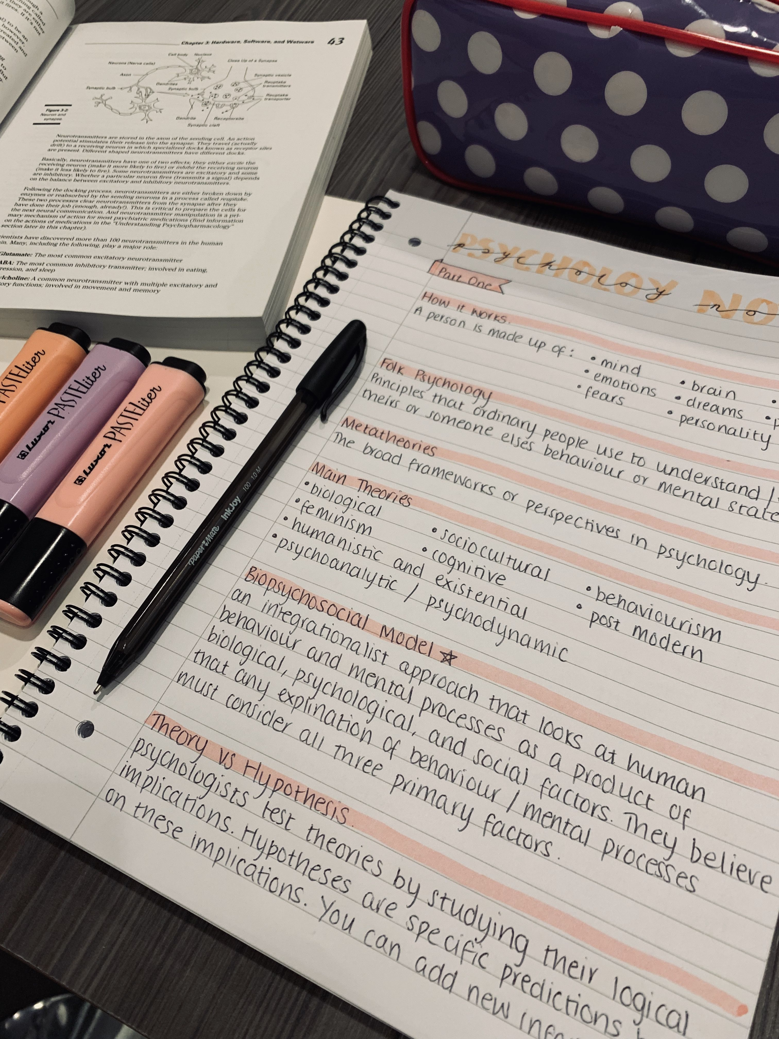
How To Use Organizational Structures?
Consider different types of structures
Outline, Mind Map, Two column, or Cornell
Use anchor points
Leave whitespace in your notes
Notes:
Overall, one of the main reasons we often take notes is so that we can come back and find important details later. By using an organizational system, you can find these details more easily, and this will help to also make the information "stick" in your memory!
As with many strategies, there's more than one approach that can be used. In the following slides, we'll take a look at some of these, as well as to see how you can find what works best for yourself, however first, lets look at some other key benefits that organizational systems allow!
Organizing our notes using systems allow us to create "anchor points" throughout our notes. Anchor points are a great way of helping to connect details to one another, as the more connections we make while notetaking, the easier it will be to remember in the future. Each of the notetaking structures have different methods of creating anchor points, which we will review further in the coming slides.
Finally however, it is also important to ensure that you leave whitespace in your notes. While it can feel intuitive to want to include as MUCH information on the page as possible, cramming details onto the page often ends up leading to us creating walls of text that are difficult to effectively use. By skipping lines and making sure to leave plenty of whitespace, this not only makes your notes easier to review, but also provides you room in case you need to go back and add additional information later.
Now lets take a look at some of these structures that are commonly used!

Slide 6
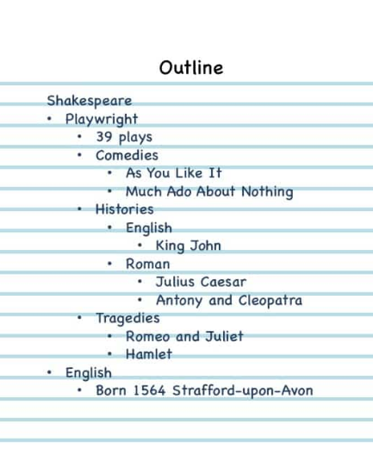
Examples of Note taking structure
Mind Map
Notes:
The first two structures we will discuss are Outlines and Mind Maps.
Outlines rely on indentation and skipping lines to show the hierarchy of information (which details are connected to one another. By writing key points, then moving to the next line, this helps leave plenty of white space, while also giving us an easy medium to tether one detail to another. In this case even if we forget details like what Shakespeare's occupation was, by having details like "39 plays", "Comedies", "Histories", and "Tragedies", this can help to remind us that he was a Playwright, effectively "anchoring" this information in our memory.
Mind Maps on the other hand allow us to visually show the connections, by creating branches between main ideas and supporting details. By starting with our topic in the center, then drawing connections to each of the details, and incorporating visuals, this novelty can make it easier to remember details when studying. Additionally, while mind maps can be very effective when creating them on by hand, there are additional free online resources that can be used like mindmup.com, which allows you to eal

Slide 7
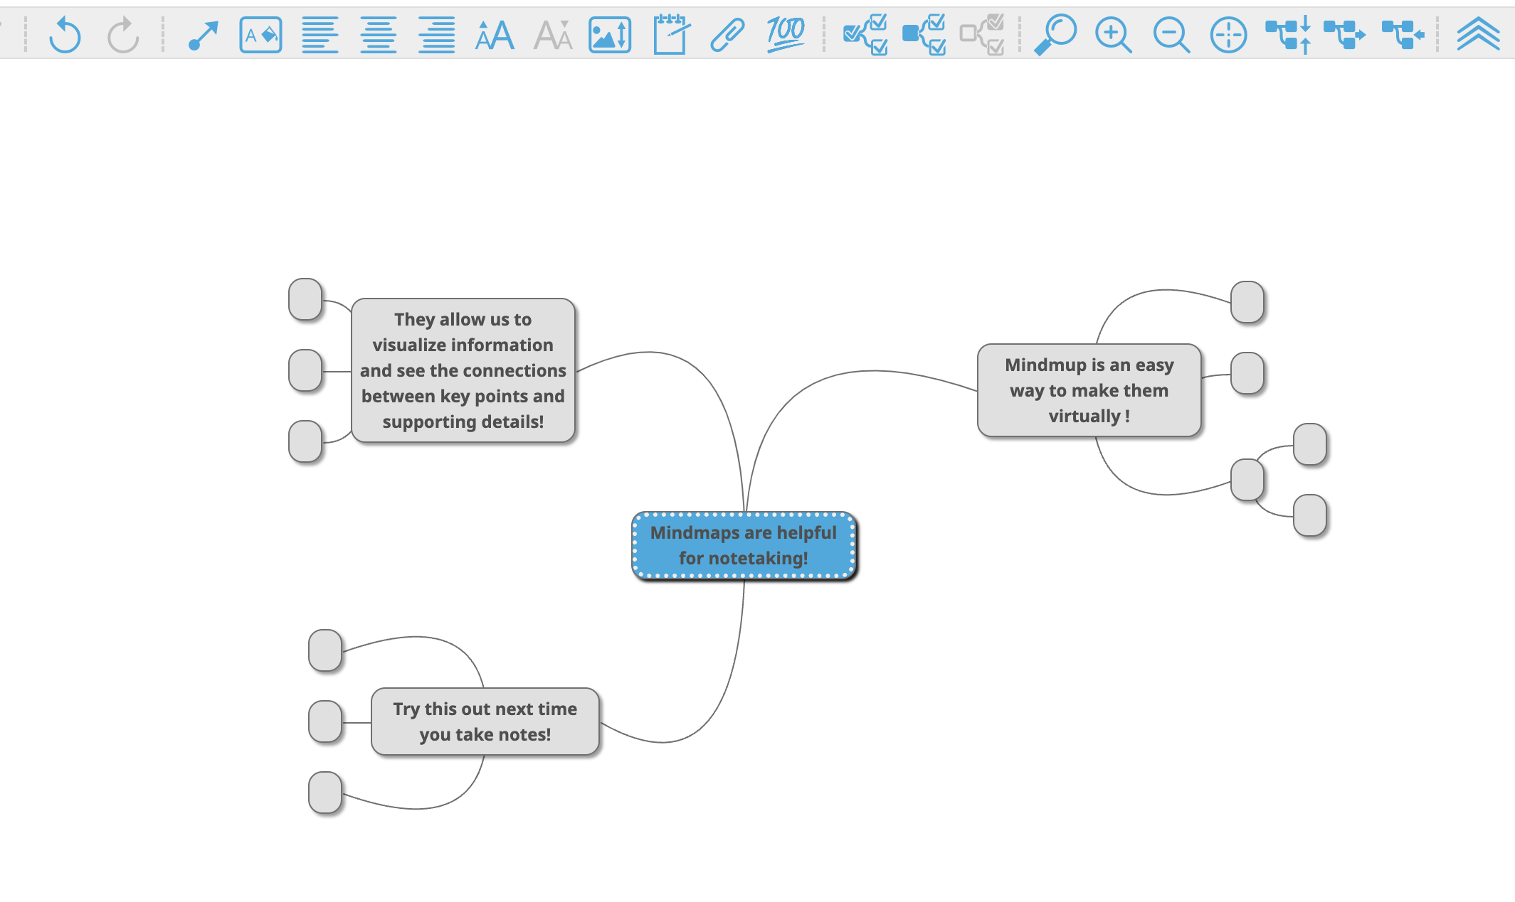
Online mindmap software example
Mindmup.com
Notes:
Additionally, while mind maps can be very effective when creating them on by hand, there are additional free online resources that can be used like mindmup.com, which allows you to create and modify mindmaps online!

Slide 8
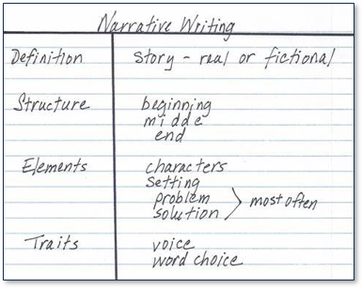
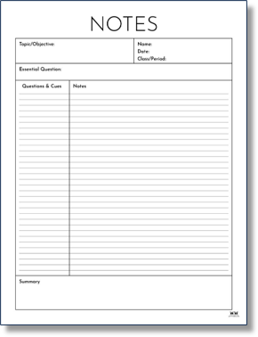
Additional examples of notetaking organization systems
Two Column
Cornell Notes
Notes:
2 more examples of structures to use when note taking
Two column
Cornell notes
Highlight how to use these / what sets them apart from two column notes
The Summary section in particular, as well as sections at the top of the page to list details about the topic / goals of the notes

Slide 9
Don't Write Everything Down
Notes:
Next, it is important to make sure we are NOT writing everything down.

Slide 10
Writing Down Just the Key Details
Why? Isn't more information better?
How do I discern what is important?
What do "Signal Cues" look like?
During a lecture
During a reading
Notes:
Even though it may feel counterintuitive to NOT write everything down, its important to recognize that even the fastest writers are not able to record everything that is said, and even If they were, this would not be salient for studying later.
Instead, when taking notes, we should listen for cues to determine what details are most important. We refer to these as "Signal cues", and there are many types that can introduce important information when taking notes!
First, during a lecture, notice points like these:
Questions: Why do you think professors ask questions?
e.g. "Who can tell me when the American Revolution was?"
If professors are checking in to confirm that everyone is following, that’s a good indicator the detail Is important.
Writing out vocab/important details on the board
Repeating themselves
e.g. "Again, the mitochondria is the POWERHOUSE of the cell."
Announcing a change in topic
e.g. "Now we're going to discuss Lewis and Clark"
All of these indicate that there is either an important detail, vocab word, or a shift in topic, which are all good to record in our notes.
Here are some things we can look for when taking notes while reading!
Topic sentences are a great way to identify new main ideas
Example sentences can help with clarifying concepts, in addition to providing isnight into how to apply them (and these often will get brought up as test or extra credit questions!)
Textbook authors will often use summaries
Text features, like if the word is bold/italic/underlined, or the author included images or diagrams can indicate what the author or publisher of the textbook considered important.
Finally, summaries can be a helpful tool when we self-monitor, or check over our notes. By reading through the summary section, and making sure we were able to include the important information that the author included, this can help you to confirm that you captured all the relevant info!
One last note before we move on, using abbreviations and shortened phrases is another way to help de-clutter your notes. Use acronyms, abbreviations, and cut out any "filler" words. Remember, your notes are for YOU, they don't need to be grammatically correct (as long as you can understand them)

Slide 11
Use Note taking Tools
Notes:
One other strategy that can be helpful when taking notes is to utilize some note taking resources!

Slide 12
Different Note Taking Tools
Evernote
OneNote
Notion
Glean
Notes:
While it is handwriting notes can be helpful for remembering the details, there is a multitude of platforms that can be used digitally to take notes as well. These can be particularly helpful if you find it tricky to keep track of notebooks, or keeping up while writing information in class.
Some popular ones inlclude Evernote, Onenote, Notion, and Glean. Though we won't go into the differences of each platform today, finding one that works if you prefer to type your notes is a great way to start your digital notetaking journey!
Furthermore, with many of these, you can use many of the same strategies that we discussed earlier, like using signal cues and incorporating a structure when taking notes.

Slide 13
Wrap up / Closing Thoughts
Notes:
Overall, while theres not one distinct "right" way to take notes, theres many ways that we can start taking more effective notes! Try out these strategies during your next seminar and notice what works!

