Slide 1

Hood College will thrive by preparing for the future, building on our strong foundation in the liberal arts and sciences.

Slide 2



Forging Our Future
These plans are rooted in our mission and motto:
Corde et Mente et Manu – With Heart and Mind and Hand.
Grow a Commitment to Service in Our Students – The HEART of learning
  Through applied learning experiences in both professional preparation and research, our students will develop an understanding of their role in building a healthier and more equitable world
  Innovate Our Programs - The nourishment of MINDS
  Degree programs in the professional health sciences and in biomedical research that will set our graduates on a course for lifelong success
Develop State-of-the-Art Facilities – The spaces for HANDS-on learning
  New and renovated facilities for research and applied learning laboratories will advance creativity, collaboration, and innovation in learning and research

Slide 3
The School of Health Sciences
Vision Statement
We will build upon Hood’s core strength in the sciences, business and liberal arts by creating degree programs that meet the growing demand for health sciences professionals, practitioners and researchers.
Degree offerings will integrate both research and practice, leveraging our existing rigorous curriculum in the sciences and our extensive partnerships to facilitate strong and innovative connections between academic research and community impact – locally, regionally and globally.
Our graduates will be well-prepared to address the most pressing issues in global health today, such as reducing health disparities and improving healthcare. They will be able to think outside the confines of a specialized field to recognize the physical, social, biological, behavioral, historical, and policy impacts on health.

Slide 4


Develop a set of new programs with a health focus through the leveraging of regional assets and our existing strengths
(Pillar 1, objective 1, subobjective b, strategy 3)
Regional Need
Community Health
Behavioral Health
Environmental Health
Biomedical Research
Strategic Goal
Mission-Centered
Liberal Arts
Rigorous science curriculum
Professional Programs
Diverse pipeline
Institutional Strengths

Slide 5

Hood is uniquely positioned and ready to establish the School of Health Sciences at this critical time when health access and quality care is a priority across the globe.
Two-Pronged 1. Interdisciplinary Programs
Approach: 2. Health Profession Programs

Slide 6
INTERDISCIPLINARY PROGRAMS
New Academic Programs:
Public Health
Sustainability Studies
Nutrition
Health Informatics
Laboratories:
Existing labs for biology, chemistry, physics, computer science, nursing
Center for Coastal & Watershed Studies
Cybersecurity & Bioinformatics lab
Kite Pharma Biotechnology Training Center
Partners:
FCHD
FITCI
Frederick Health
Kite-Pharma
Leidos/FNCL
NCI/NIH
NIAD
And you!

Slide 7

PUBLIC HEALTH
Bachelor of Arts
Launched Fall 2020
Incorporates the interdisciplinary approaches of epidemiology, biostatistics and health services, environmental health, behavioral health and public policy.
Our extensive community and clinical partnerships are a critical component of the curriculum, providing students with applied learning and research opportunities and to positively impact the communities they will serve.
Will be the first nationally accredited Bachelor of Arts in Public Health in Maryland

Slide 8
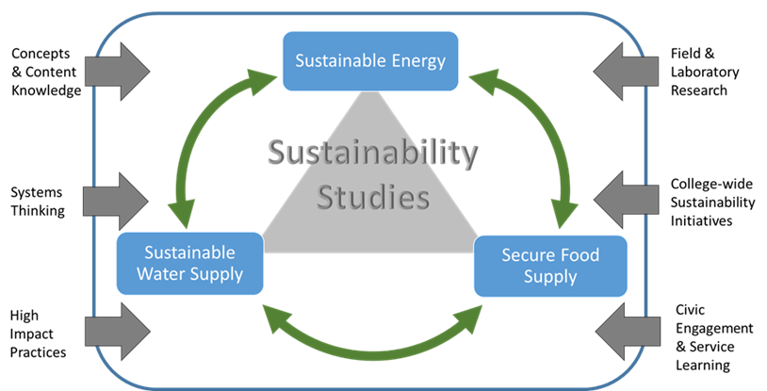
SUSTAINABILITY STUDIES
Examines the relationship between human health and the environment
Three interrelated areas: the Food-Water-Energy (FWE) nexus
  Sustainable watershed
  Sustainable energy
  Food systems dynamics
Features systems thinking, high-impact practices, content knowledge, field and laboratory research, college-wide sustainability initiatives, and civic engagement and service learning

Slide 9
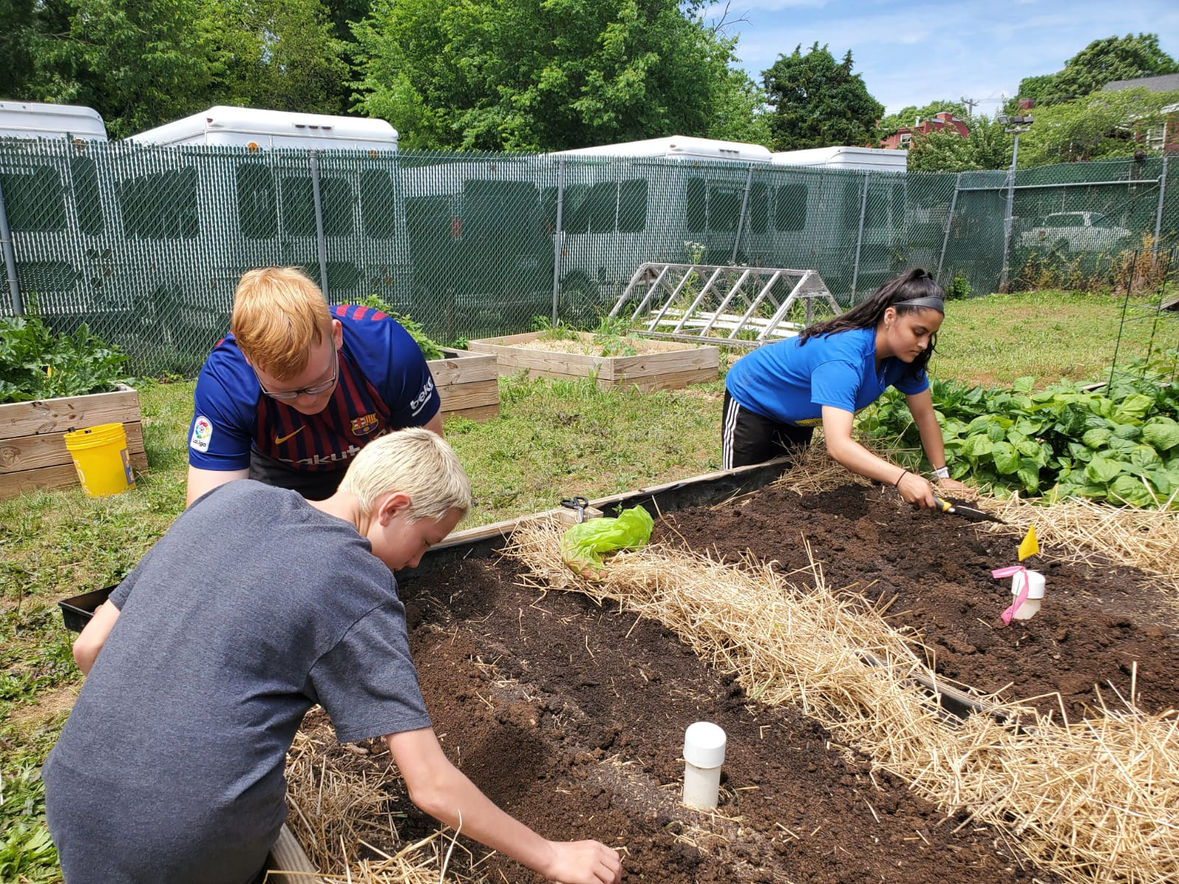
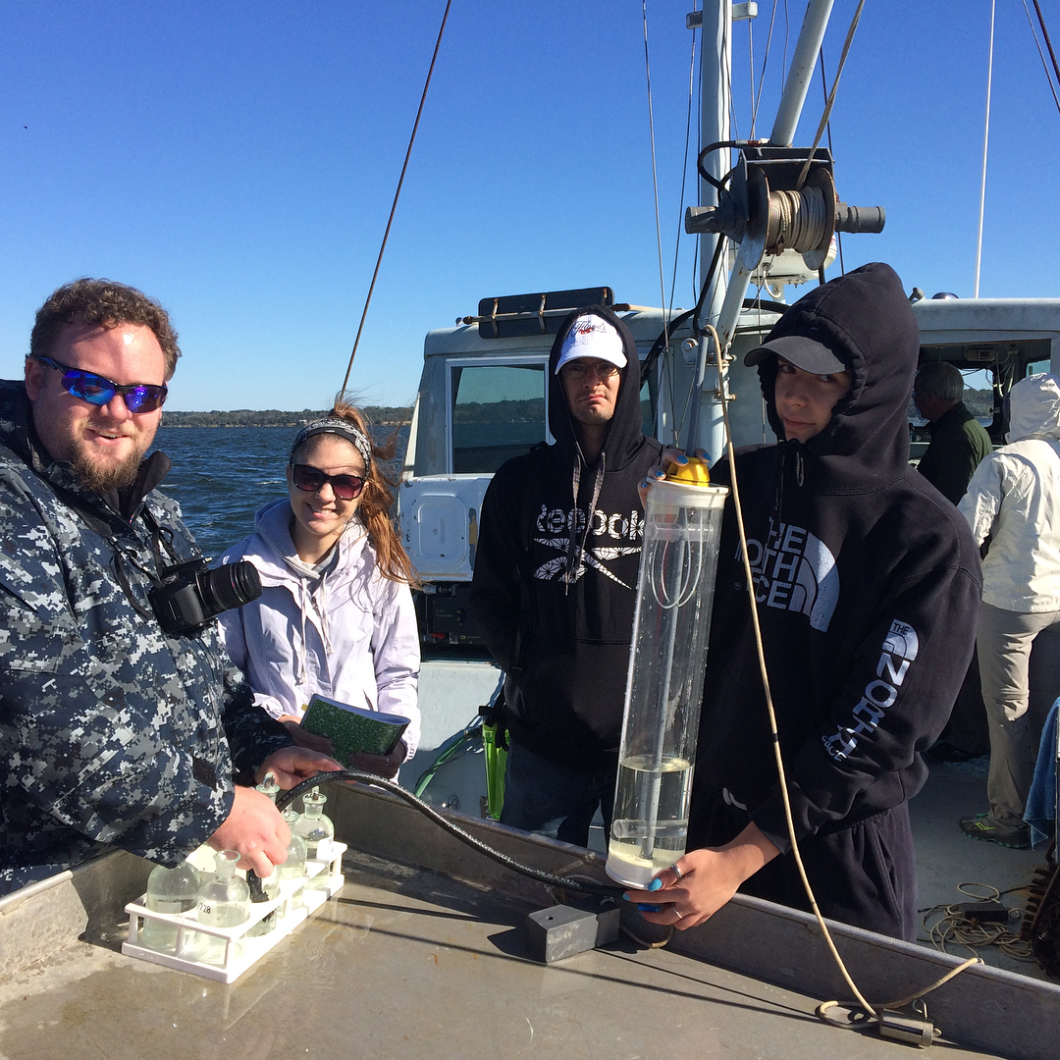
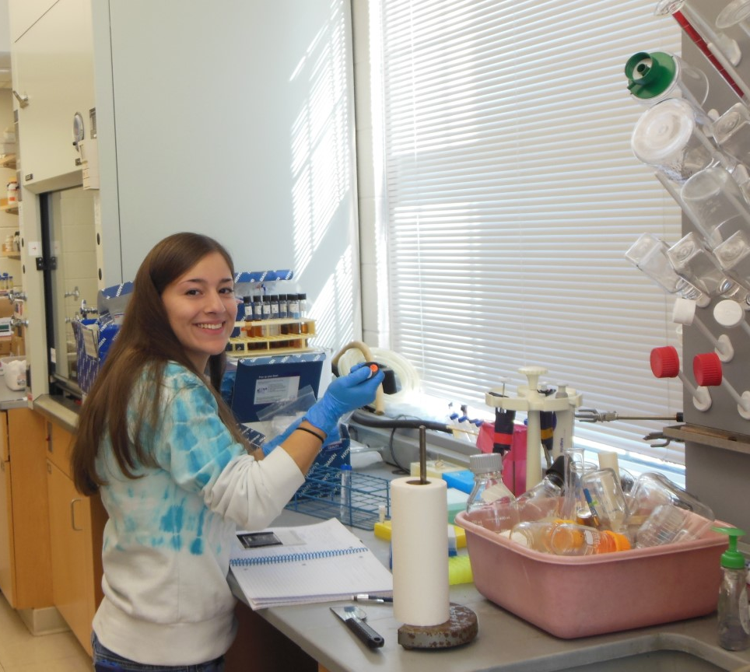
Unique Attributes of the Program
Frederick Food Security Network
(Community Food Systems)
Center for Coastal and Watershed Studies
(Watershed Sustainability)
Biofuels Research
(Plant-based Fuel Development)
We currently have opportunities to involve students in all FWE nexus experiences.
Notes:
Any sustainability issue that involves one of these factors invariably has repercussions on the other two.
The application of the WEF nexus has increased rapidly and is now an accepted approach to the study of sustainability issues.

Slide 10


HEALTH INFORMATICS
Bioinformatics
Health Informatics
Data handling and data analysis of biology studies that examine genes, proteins, and metabolites.
Advances basic life science knowledge to understand human health, disease and treatment.
Analysis of healthcare data (clinical and/or patient records) to assess:
  Clinical outcomes
  Healthcare costs
  Patient satisfaction
  Improved, targeted programming
Advances research, education, public health, and patient care.

Slide 11
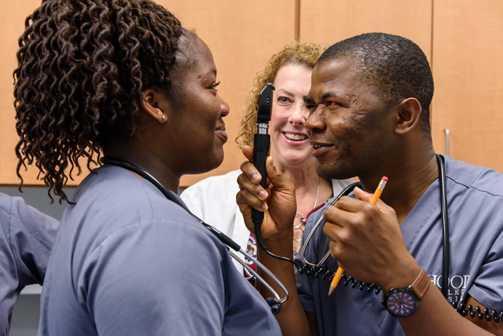

HEALTH PROFESSION PROGRAMS
Programs:
Nursing
Nutrition
And more to come!
Laboratories:
Expansion of existing labs and simulation rooms for nursing
Expansion of placement sites at FH, Meritus and others

Slide 12

NURSING
BSN program established in 2015
Consistent with our vision for the School of Health Sciences, one of the curriculum's strength is a focus on community health
Largest major; in 2020 a record class of 20 BSN graduates.
In partnership with Frederick Health, this fall we will expand capacity by using shared space for classrooms, simulation labs and laboratories for the nutrition program and for onsite training for FH employees
We are currently developing a proposal for a Doctorate in Nurse Practitioner

Slide 13

NUTRITION
Masters of Science in Nutrition, anticipated launch in Fall 2021
Both strong research and applied experience foci built into curriculum
Three tracks, the first of which will lead to the registered dietician credential
The other two tracks will be unique in MD and will capitalize on Hood’s strengths in business and biology, respectively, and our partnerships with the local agricultural industry, the USDA, the local farm-to-table movement, FFSN, and retail food establishments
It also will intersect with the Public Health program to enable students to explore the social, political and economic systems that support or create barriers to accessing healthy, sustainable food

Slide 14
Nutritional Sciences
Nutrition Science (NS)
Metabolic and physiological responses to diet
Dietetics (FG)
Science of nutrition & its health applications
Sustainable Nutrition (SN)
Health-social-ecological-political applications

Slide 15

Q & A
Feedback
Other Programs?
How can we partner with you?

